Slide 1
Machine Learning for Computer Systems
Nick Feamster University of Chicago

Slide 2
Data Acquisition: “You Can’t Improve What You Don’t Measure.”

Slide 3
The Role of Measurement in Operations
Performance and Reliability
Generate reports for customers and internal groups
Diagnose performance and reliability problems
Tune the configuration of the network to the traffic
Plan outlay of new equipment (routers, proxies, links)
Security
Detect and mitigate attacks
Determine source of attacks

Slide 4
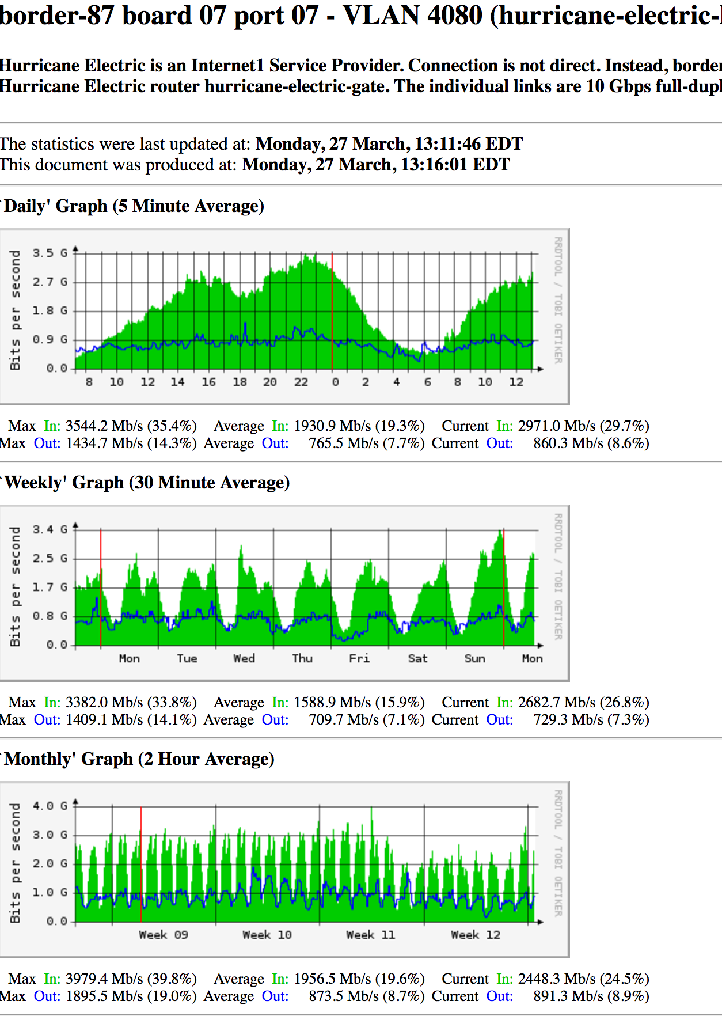

Slide 5
Types of Measurements
Active
Passive
traceroute
ping
UDP probes
TCP probes
Application-level probes
Web downloads
DNS queries
Packet traces
Complete
Headers only
Specific protocols
Flow records
Specific data
Syslogs …
HTTP server traces
DHCP logs
Wireless association logs
DNSBL lookups
…
Routing data
BGP updates / tables, ISIS, etc.

Slide 6
Tools and Pitfalls
Aspects of Data Collection
Precision: At what granularity are measurements taken?
Accuracy: Does the data capture phenomenon of interest?
Context: How was the data collected?
Tools
Active
Ping, traceroute, etc.
Accuracy pitfall example: traceroute
Passive
Packet captures (e.g., tcpdump, DAG)
Flow records (e.g., netflow)
Routing data (e.g., BGP, IS-IS, etc.)
Context pitfall example: eBGP multihop data collection

Slide 7
Strategies for Sound Internet Measurement
Cross validation
consistency checks
multiple “overlapping” measurements
database is a useful tool for cross-checking
Other considerations
Anonymization and privacy
Maintaining longitudinal data

Slide 8
Part 1: Active Measurement

Slide 9
Active Measurement Tasks
Basic reachability (ping)
Topology discovery (traceroute)
Performance measurement (speed tests, web tests, etc.)

Slide 10
Hands-On 1: Measuring Paths with Traceroute

Slide 11
How Traceroute Works
Send packets with increasing TTL values
TTL=1
TTL=2
TTL=3
ICMP “time exceeded
Nodes along IP layer path decrement TTL
When TTL=0, nodes return “time exceeded” message

Slide 12
Problems with Traceroute
Can’t unambiguously identify one-way outages
Failure to reach host : failure of reverse path?
ICMP messages may be filtered or rate-limited
IP address of “time exceeded” packet may be the outgoing interface of the return packet
TTL=1
TTL=2
TTL=3

Slide 13
Active Measurement Tasks
Basic reachability (ping)
Topology discovery (traceroute)
Performance measurement (speed tests, web tests, etc.)

Slide 14
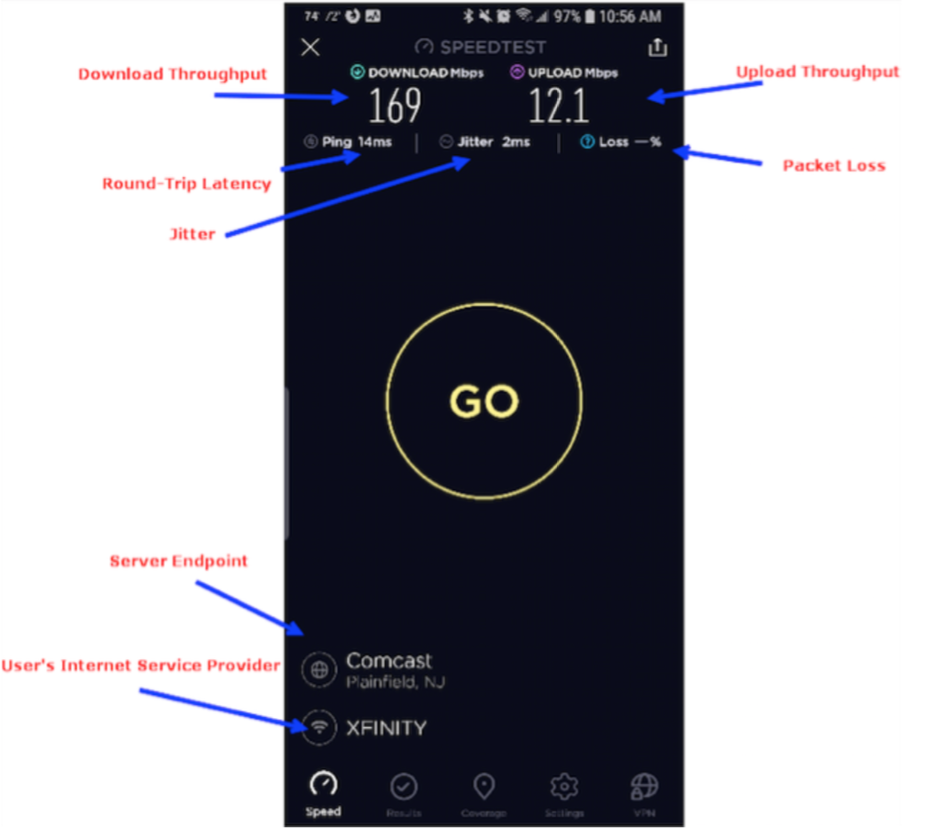
“Speed” Has Many Facets
Throughput (up, down)
Latency
Jitter
Packet Loss

Slide 15
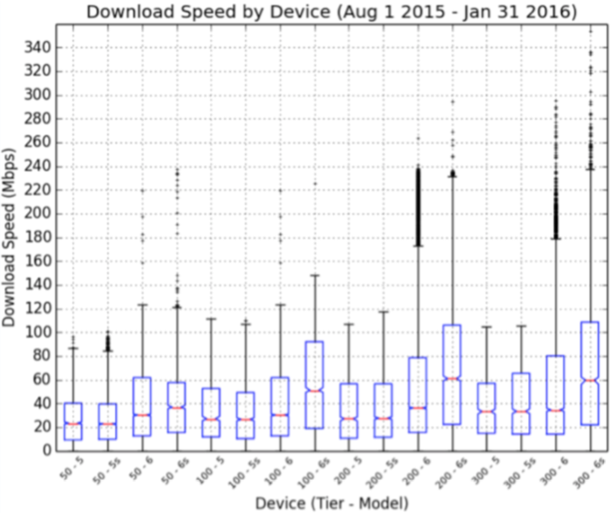
The Device Can be the Bottleneck
Older iPhones do not support 802.11ac, so never exceed 100 Mbps!

Slide 16
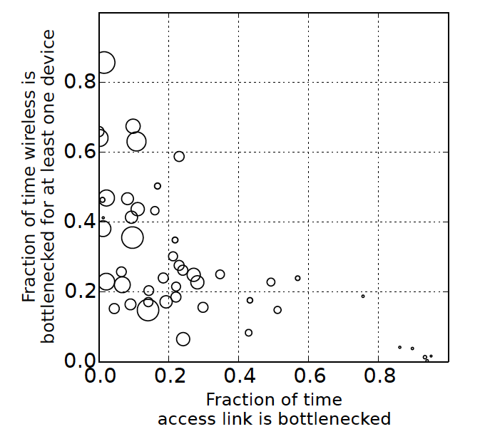
The Home Network Can Be the Bottleneck
Wireless bottlenecks are common, especially as throughput increases
Access link bottlenecks are rare, only happens at low throughput
Homes with throughput greater than 35 Mbits/s almost never see access link bottleneck. (2015)
Sundaresan, S., Feamster, N., & Teixeira, R. (2016, March). Home network or access link? locating last-mile downstream throughput bottlenecks. In International Conference on Passive and Active Network Measurement (pp. 111-123).

Slide 17
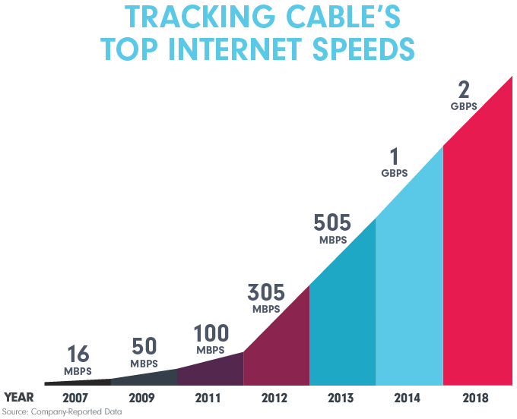
As Speeds Get Faster, Speed Testing Gets Harder
Measuring access links is getting harder.
Conventional tests take more data.
Bottlenecks are moving elsewhere.
Apps don’t saturate the access network capacity.
Notes:
This problem was never easy, but it’s getting more challenging!

Slide 18
Part 2: Passive Measurement

Slide 19
Tasks for Passive Measurement
Performance
Utilization
Capacity
Application performance
Security
Attack detection
Anomaly detection

Slide 20
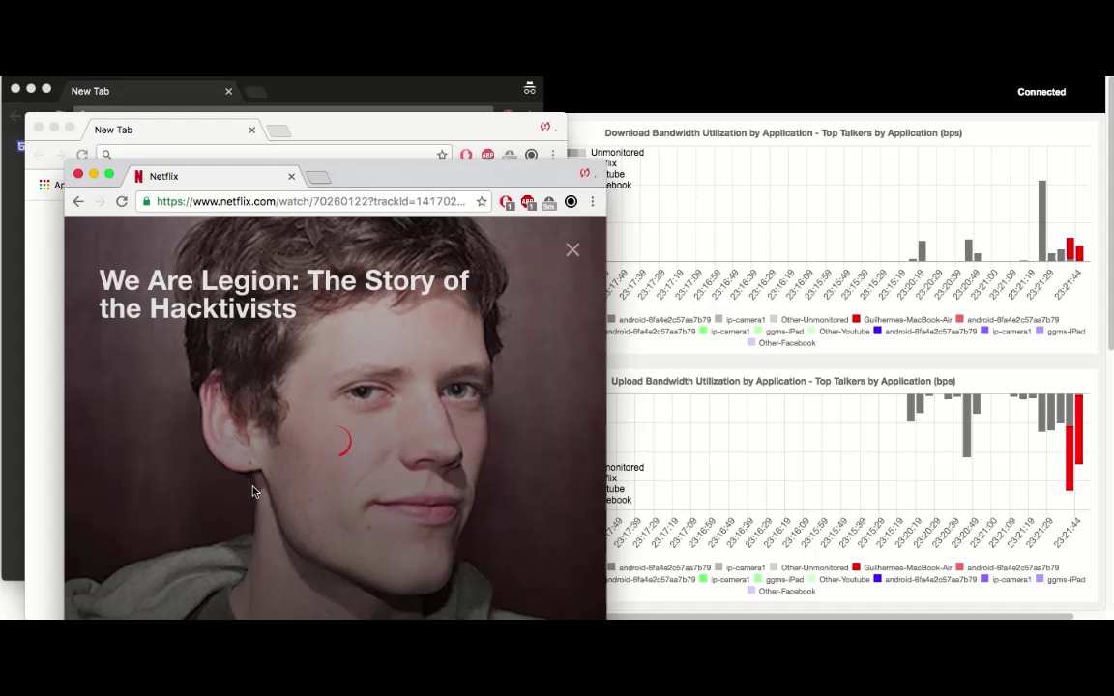

Slide 21
Two Main Approaches
Packet-level Monitoring
Keep packet-level statistics
Examine (and potentially, log) variety of packet-level statistics. Essentially, anything in the packet.
Timing
Flow-level Monitoring
Monitor packet-by-packet (though sometimes sampled)
Keep aggregate statistics on a flow

Slide 22
Traffic Flow Statistics
Flow monitoring (e.g., Cisco Netflow)
Statistics about groups of related packets (e.g., same IP/TCP headers and close in time)
Recording header information, counts, and time
More detail than SNMP, less overhead than packet capture
Typically implemented directly on line card

Slide 23
What is a flow?
Source IP address
Destination IP address
Source port
Destination port
Layer 3 protocol type
TOS byte (DSCP)
Input logical interface (ifIndex)

Slide 24
IPFIX (Cisco Netflow, Sflow, etc.)
Basic output: “Flow record”
Newer versions have:
More flexible record format
Much easier to add new flow record types
Core Network
Approximately 1500 bytes
20-50 flow records
Sent more frequently if traffic increases
Collector (PC)
Collection and Aggregation

Slide 25
What is in a Flow Record?
Basic information about the flow…
Source and Destination, IP address and port
Packet and byte counts
Start and end times
ToS, TCP flags
…plus, information related to routing
Next-hop IP address
Source and destination AS
Source and destination prefix

Slide 26
Aggregating Packets into Flows
flow 1
flow 2
flow 3
flow 4
Criteria 1: Set of packets that “belong together”
Source/destination IP addresses and port numbers
Same protocol, ToS bits, …
Same input/output interfaces at a router (if known)
Criteria 2: Packets that are “close” together in time
Maximum inter-packet spacing (e.g., 15 sec, 30 sec)
Example: flows 2 and 4 are different flows due to time

Slide 27
Packet Sampling
Packet sampling before flow creation (Sampled Netflow)
1-out-of-m sampling of individual packets (e.g., m=100)
Create of flow records over the sampled packets
Reducing overhead
Avoid per-packet overhead on (m-1)/m packets
Avoid creating records for a large number of small flows
Increasing overhead (in some cases)
May split some long transfers into multiple flow records
… due to larger time gaps between successive packets
time
not sampled
timeout
two flows

Slide 28
Problems with Packet Sampling
Determining size of original flows is tricky
For a flow originally of size n, the size of the sampled flow follows a binomial distribution
Extrapolation can result in big errors
Much research in reducing such errors (upcoming lectures)
Flow records can be lost
Small flows may be eradicated entirely

Slide 29
Flow-Level Sampling
Sampling of flow records evicted from flow cache
When evicting flows from table or when analyzing flows
Stratified sampling to put weight on “heavy” flows
Select all long flows and sample the short flows
Reduces the number of flow records
Still measures the vast majority of the traffic
Flow 1, 40 bytes
Flow 2, 15580 bytes
Flow 3, 8196 bytes
Flow 4, 5350789 bytes
Flow 5, 532 bytes
Flow 6, 7432 bytes
sample with 0.1% probability
sample with 100% probability
sample with 10% probability

Slide 30
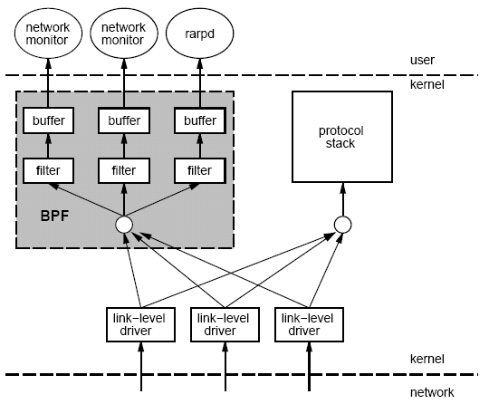
Packet Capture: tcpdump/bpf
Put interface in promiscuous mode
Use bpf to extract packets of interest
Accuracy Issues
Packets may be dropped by filter
Failure of tcpdump to keep up with filter
Failure of filter to keep up with dump speeds
Question: How to recover lost information from packet drops?

Slide 31
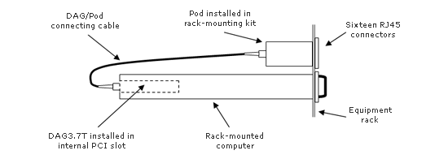
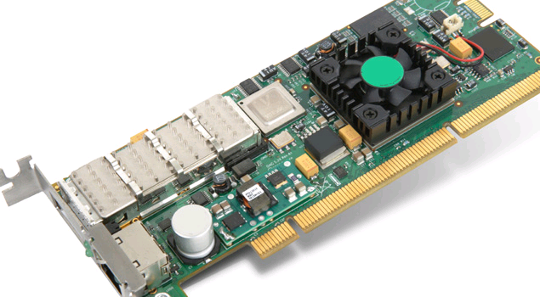
Packet Capture on High-Speed Links
Example: Georgia Tech “OC3Mon”
Rack-mounted PC
Optical splitter
Data Acquisition and Generation (DAG) card
Source: endace.com

Slide 32
Characteristics of Packet Capture
Allows inpsection on every packet on 10G links
Disadvantages
Costly
Requires splitting optical fibers
Must be able to filter/store data

Slide 33
Traditional network representations limit flexibility
Solely relying on features offered by existing network infrastructure fails to maximize performance
Challenges transitioning from a lab to the real world
Scaling datasets
Estimate representations costs
Notes:
traditional network traffic representations inherently limit flexibility to minimize cost (netflow) or are too costly (pcap)
Challenges of transitioning from a lab to real world
Existing traffic representations. A cost is

Slide 34



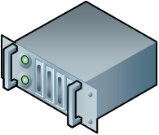

Online joint exploration of model cost and performance
Challenges:
Enable max flexibility
Cope with increasing speeds
Realistic profiling
Traffic
Refinery
Models that meet performance requirements
Models that satisfy cost constraints
Target models
Notes:
Left side: exploration of representations, critical to maximize performance
Right side: but we have to account possible constraints of possible hardware

Slide 35
Exploring data representations with Traffic Refinery
Traffic Categorization
1. Service driven packet processing
IP-to-Service map
Update
URL / IP Signatures
DNS traffic
Lookup
Packet Processing
2. Real time processing
Service based processing
Service based processing
Flow Cache
Update
Service based processing
Rest of traffic
Profiling routines
Collect
3. Built-in profiling
Stats Collection
Permanent DB
Stats Collection
Stats Collection
Long Term Storage

Slide 36
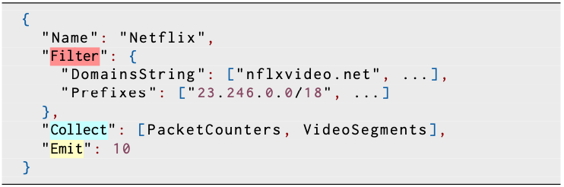
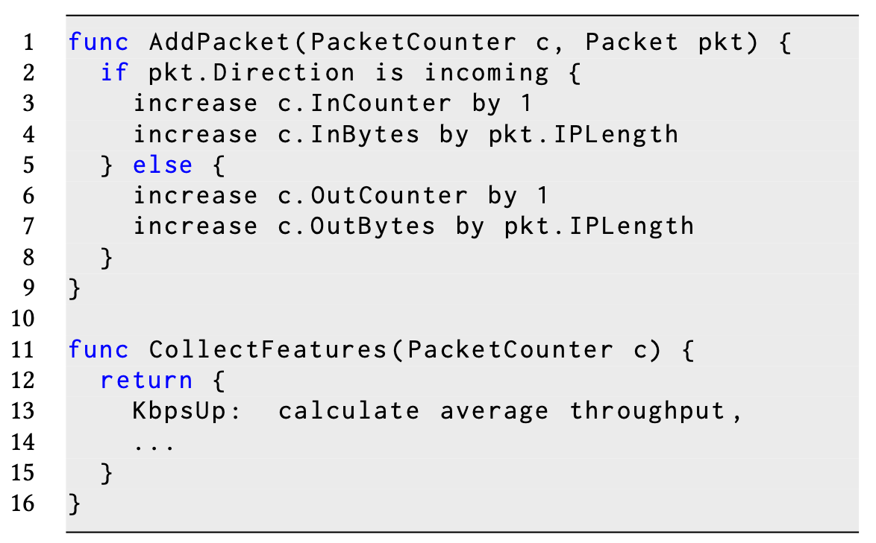
Service driven packet processing
Specify services of interest
Implement missing features
Traffic Categorization
IP-to-Service map
Update
URL / IP Signatures
DNS traffic
Lookup
Packet Processing
Service based processing
Service based processing
Flow Cache
Update
Service based processing
Rest of traffic
Profiling routines
Collect
Stats Collection
Permanent DB
Stats Collection
Stats Collection
Long Term Storage

Slide 37
Real time processing
Early packets discarding
Scales with number of cores available
Up to 10 gpbs support
Pcap traces replay
Traffic Categorization
IP-to-Service map
Update
URL / IP Signatures
DNS traffic
Lookup
Packet Processing
Service based processing
Service based processing
Flow Cache
Update
Service based processing
Rest of traffic
Profiling routines
Collect
Stats Collection
Permanent DB
Stats Collection
Stats Collection
Long Term Storage

Slide 38
Built-in features profiling
Per features group profiling of costs
State
Processing
Storage
Same running configuration but profile each feature in isolation
Traffic Categorization
IP-to-Service map
Update
URL / IP Signatures
DNS traffic
Lookup
Packet Processing
Service based processing
Service based processing
Flow Cache
Update
Service based processing
Rest of traffic
Profiling routines
Collect
Stats Collection
Permanent DB
Stats Collection
Stats Collection
Long Term Storage

Slide 39
System evaluation
Pick of drops correspond to the arrival of new flows

